Slide 1
JOURNEY PPT
ANSUMAN NAYAK
ANSUMAN NAYAK
655475
INANJJ

Slide 2
WEEK 5 - AGENDA(CUSTOM IDA)
Day 1 - Python
Day 2 - Python
Day 3 - PySpark 1
Day 4 - PySpark 2

Slide 3
DAY – 1 (PYTHON 1)
-> Args
-Dont know how many args we need to add
-* appear before the parameter
- Function-> Its a behavior
def my_func(*products):
print("The costly product in the collection is: "+products[3]")
my_fuction("k","m","f","g","s")
--> kwargs - keyword arguments (key, value)
- when number of kwargs is not known
-** appear before the parameter
def my_func(**product):
print("The hardware product name is: "+product["productname"])
my_func(productname="Mouse", brandname="Logitech")

Slide 4
DAY – 1 (PYTHON 1)
Keyword and positional parameters
- keyword-only argument
1. Parameter names are used to pass the arg during function call
2. order of the parameters can be changed while passing the info
3. function_name(parameterName ="value")
def nameAge(name,age):
print("Hi, I am", name)
print("my age is", age)
#following the order of arguments
nameAge(name="Gyanesh", age= 31)
#changing the order of the arguments
nameAge(age= 35, name="Gyan")
- Positional-only arguments
1. we need to maintain the order of the passing args. the args should be defined while passing parameter
2. order must not be changed
3. function_name(value1, value2)
#Positional parameter demo
def nameAge(nvame, age):
print("Hi, I am", name)
print("my age is", age)
print("case-1")
nameAge("john",20)
print("case-2")
nameAge(20, "john")
def minus(firstnum, secondnum):
return firstnum-secondnum
firstnum, secondnum = 20,11
result1 = minus(firstnum, secondnum)
print("used positional args",reult1)
result2 = minus(secondnum, firstnum)
print("used positional args",reult2)

Slide 5
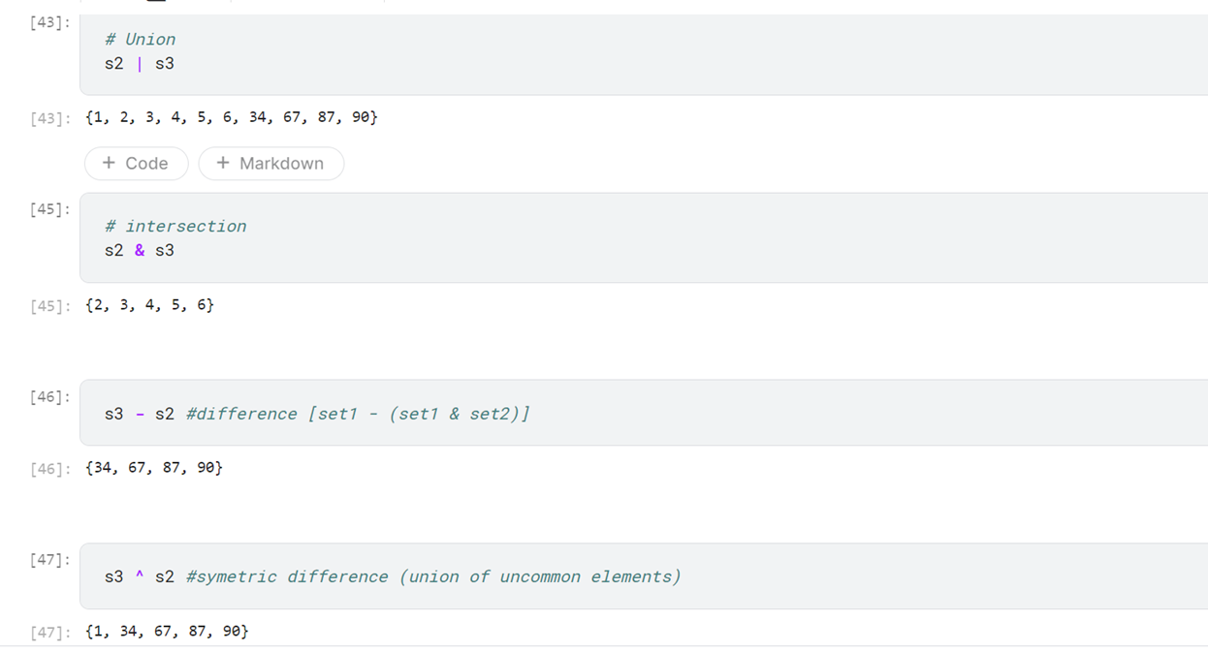
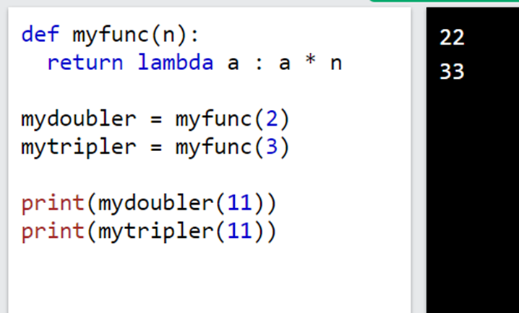
DAY – 1 (PYTHON 1)
Lambda Function
- A lambda function is a small anonymous function.
- A lambda function can take any number of arguments, but can only have one expression.
Syntax
•lambda arguments : expression

Slide 6
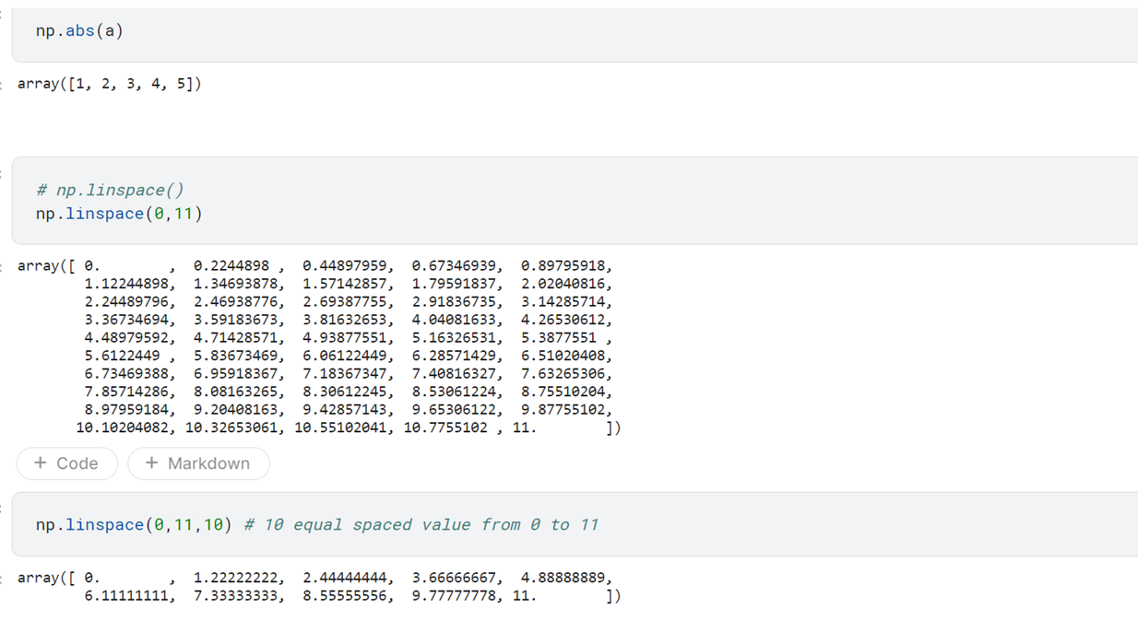
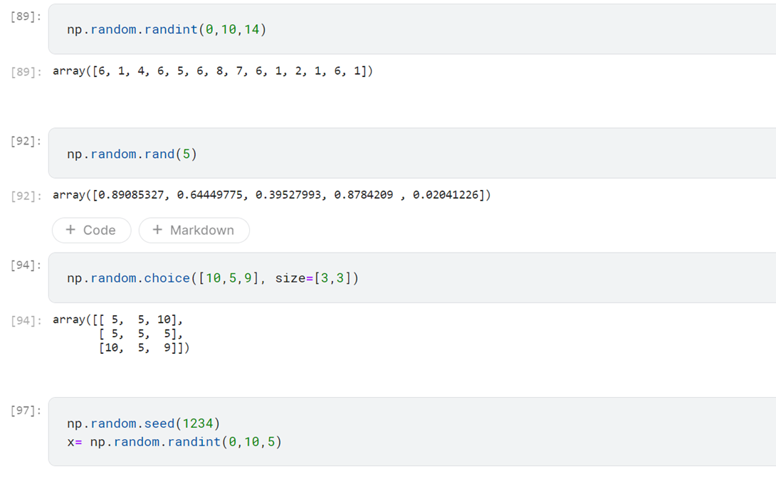
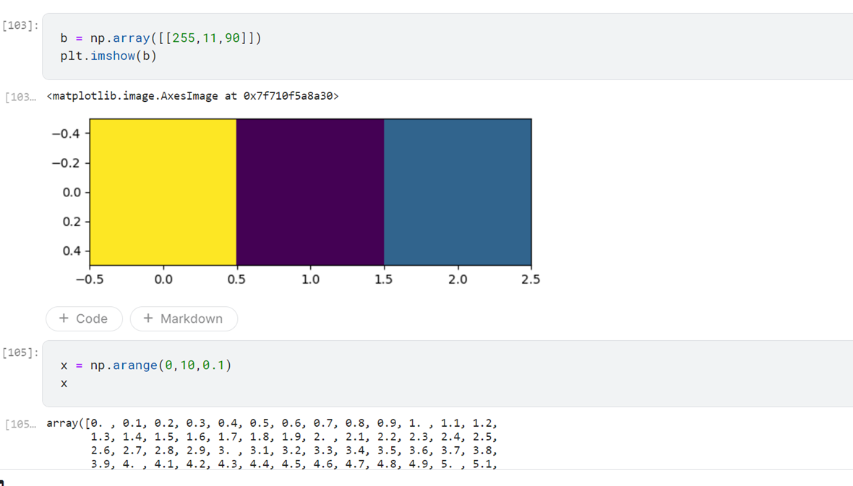
DAY – 1 (PYTHON 1)

Slide 7
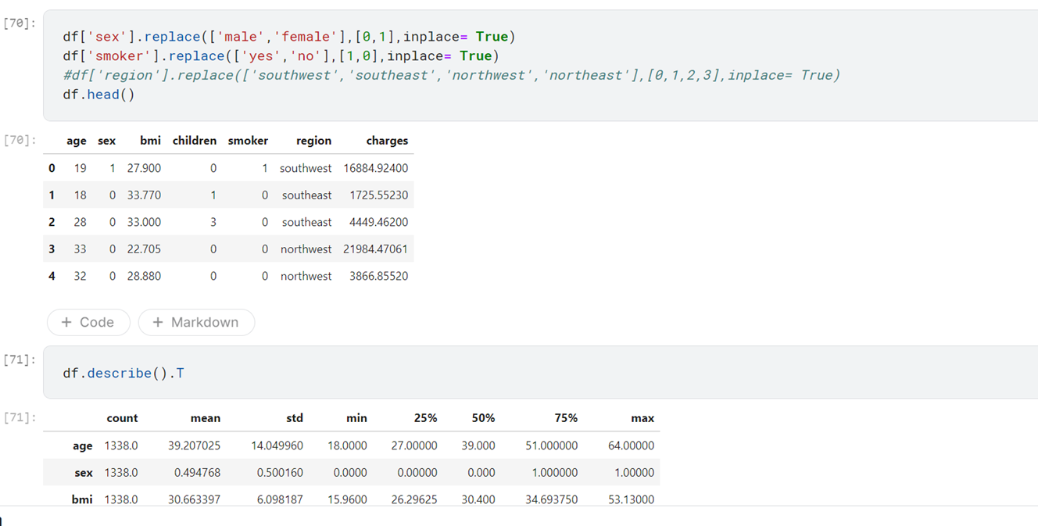
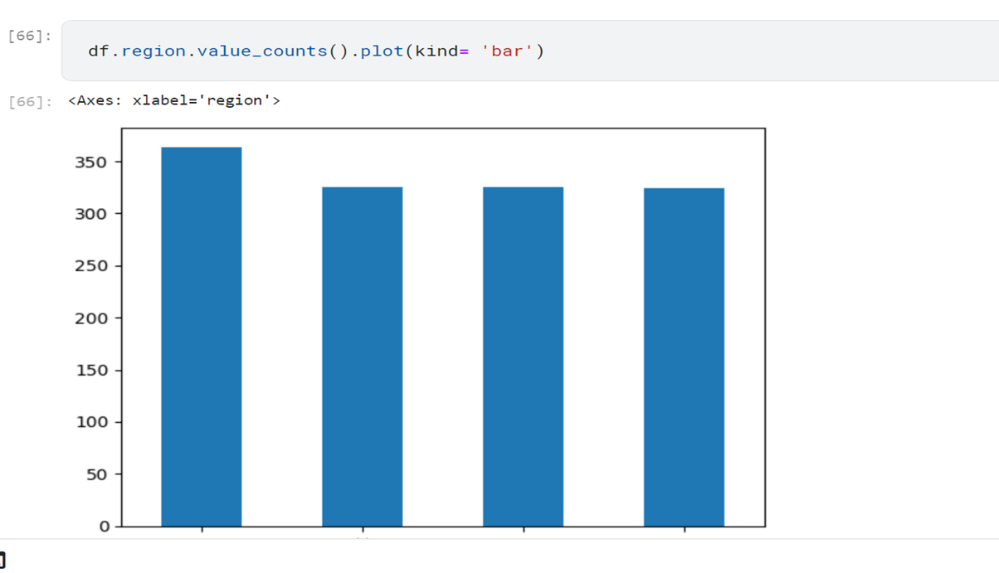
DAY – 2 (PYTHON 2)

Slide 8
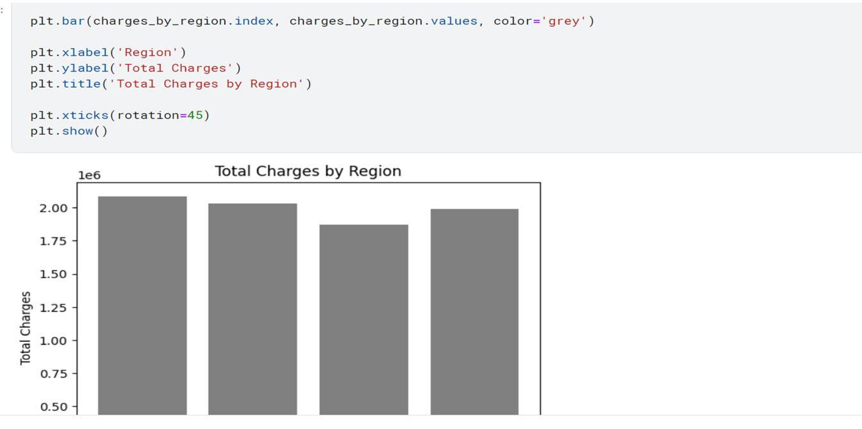
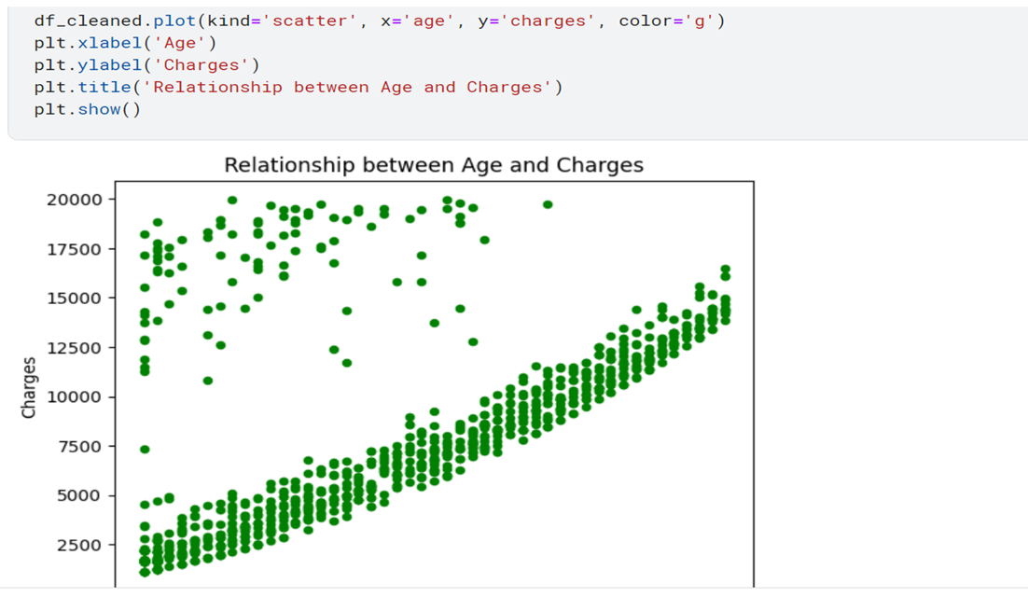
DAY – 2 (PYTHON 2)

Slide 9
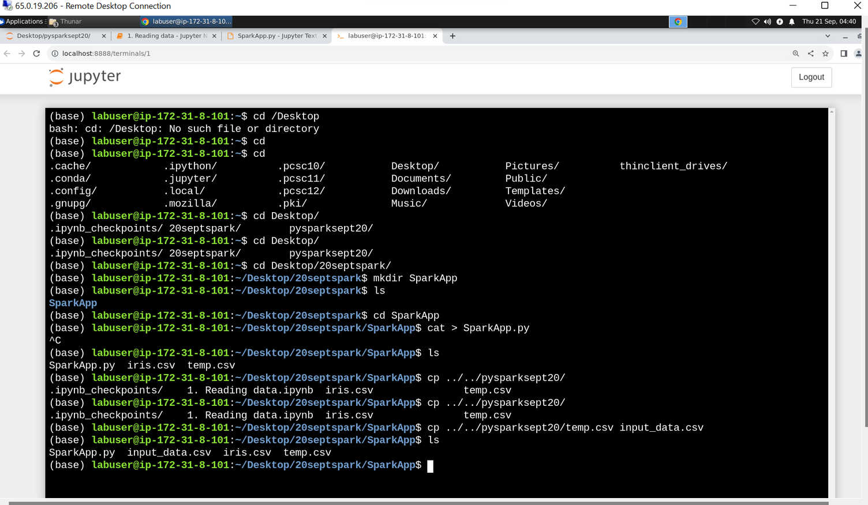
DAY – 3 (PYSPARK 1)
PySpark is an open-source, distributed computing framework for big data processing that is built on top of the Apache Spark project. It provides a Python API for interacting with Spark
key features and components of PySpark:
Distributed Data Processing
Resilient Distributed Datasets (RDDs)
DataFrame API
Machine Learning Library (MLlib)
Structured Streaming
Integration with Other Data Sources
Interactive Shell
Ease of Use
Starting a spark app

Slide 10
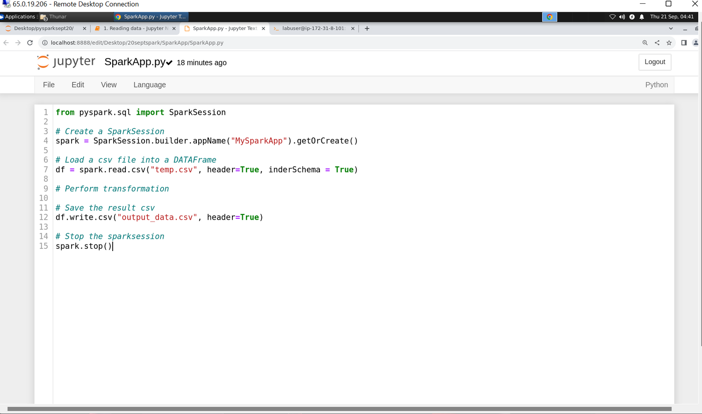
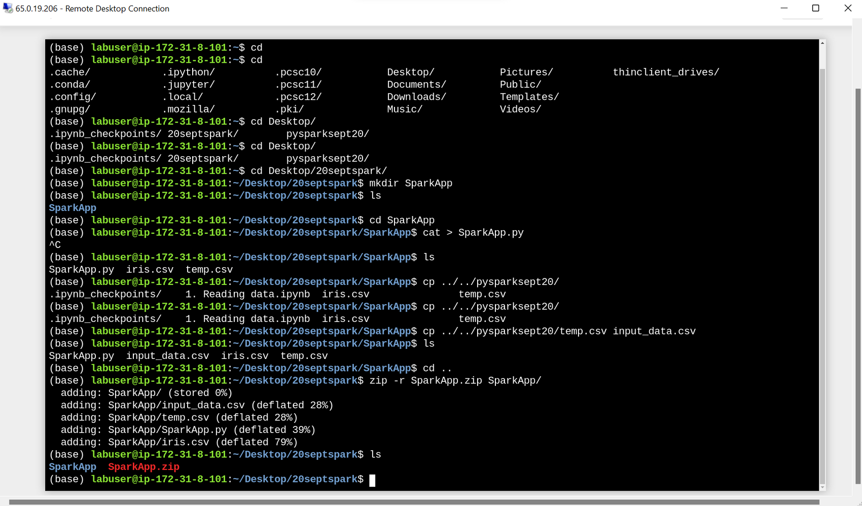
DAY – 3 (PYSPARK 1)
Spark App code
Creating a zip file containing input_data.csv and sparkapp.py

Slide 11
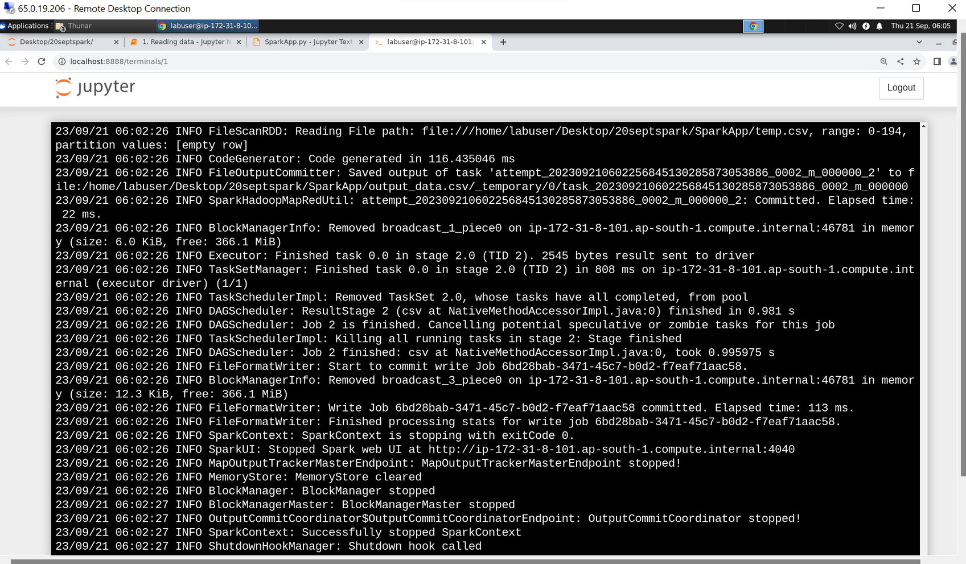
DAY – 3 (PYSPARK 1)
Successfully submitting a spark job

Slide 12
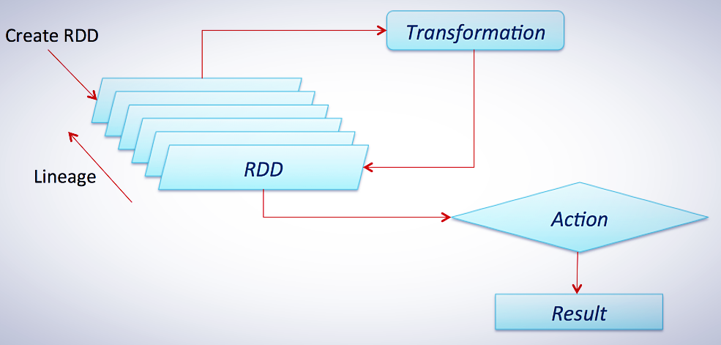
DAY – 4 (PYSPARK 2)
RDD, which stands for Resilient Distributed Dataset, is a fundamental data structure in Apache Spark. RDDs are used in Spark for several important reasons:
Distributed Data Processing
Fault Tolerance
In-Memory Storage
Data Transformation
Lazy Evaluation
Compatibility
Language Support: Multiple programming languages, including Scala, Java, and Python.
Transformations are operations that create a new RDD from an existing one. They are typically lazy, meaning they are not executed immediately but are evaluated when an action is called.
Actions are operations that trigger the execution of transformations and return a value or write data to an external system. They initiate the actual computation on the RDD.

Slide 13
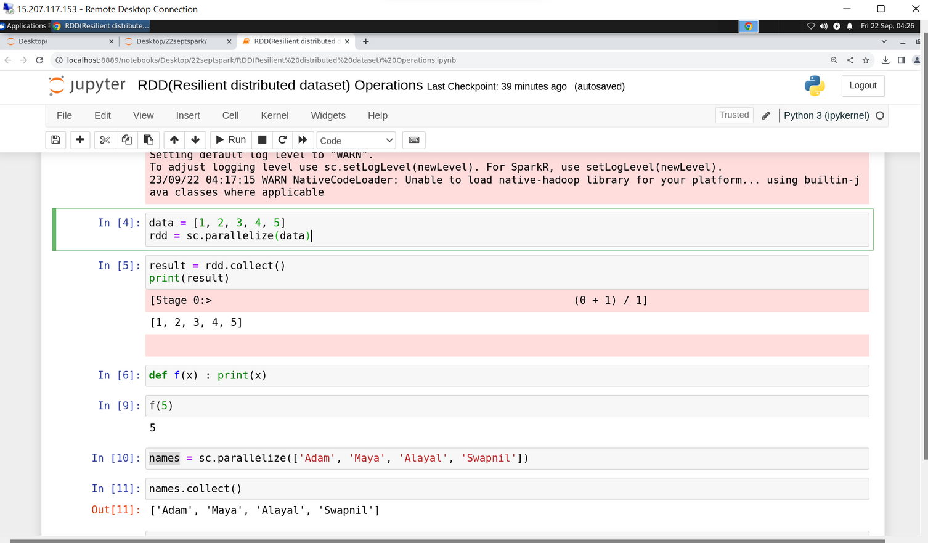
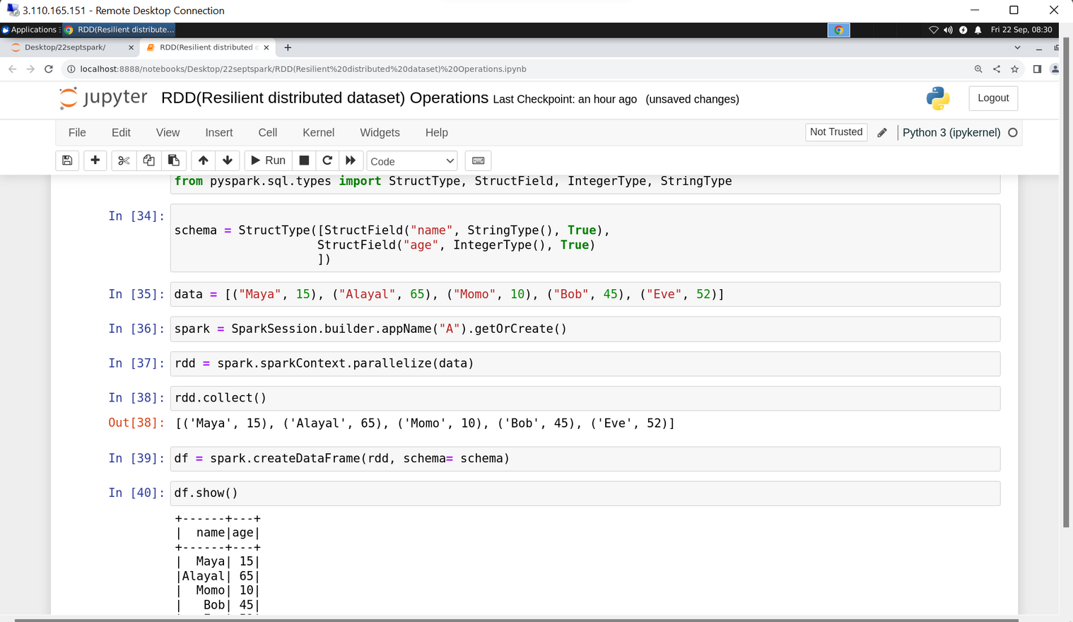
DAY – 4 (PYSPARK 2)
Creating a spark object: rdd
Defining schema for spark dataframe

Slide 14
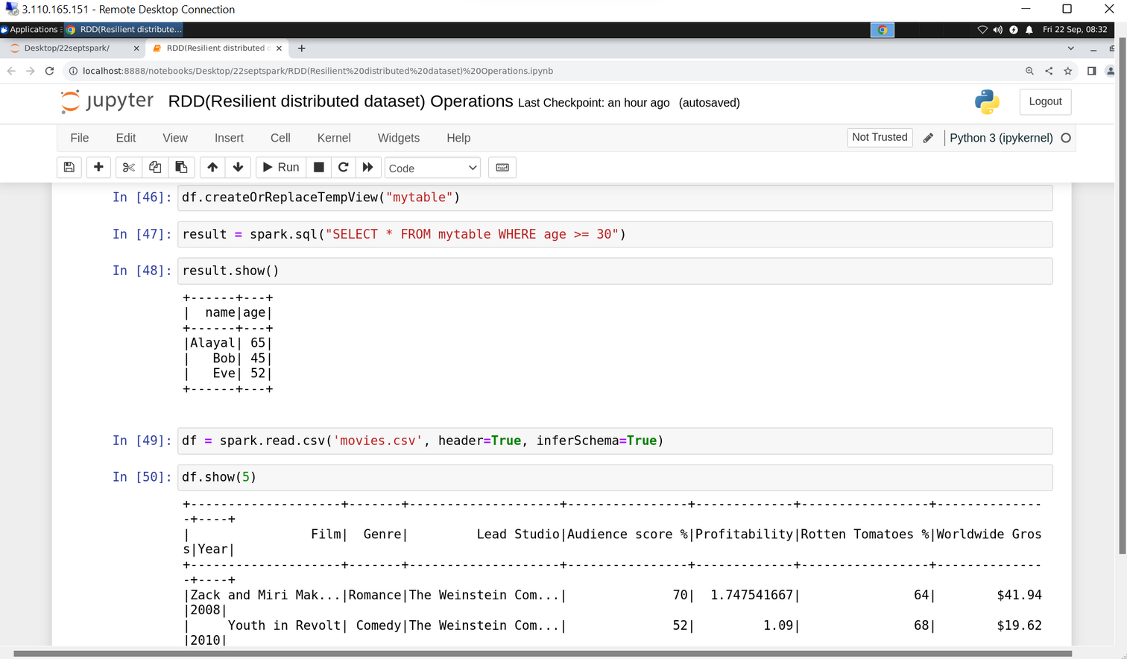
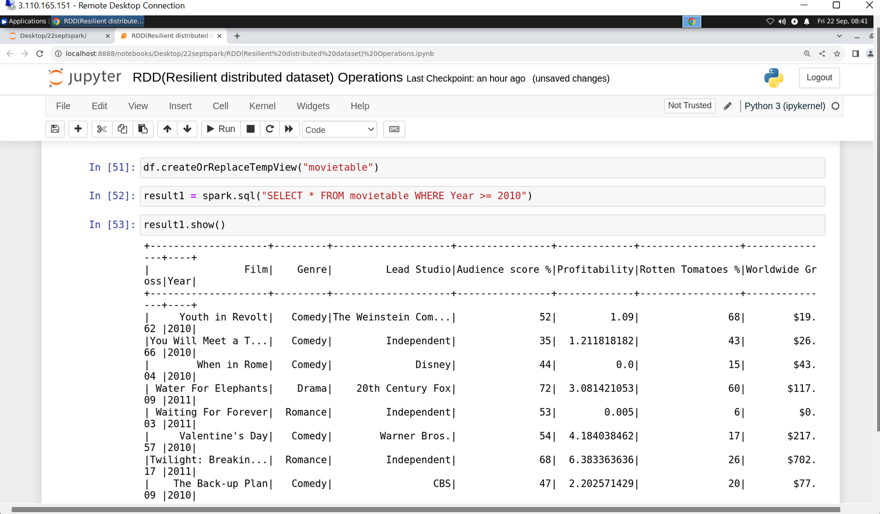
DAY – 4 (PYSPARK 2)
creating a sql table using spark sql
filtering data using sql queries

Slide 15
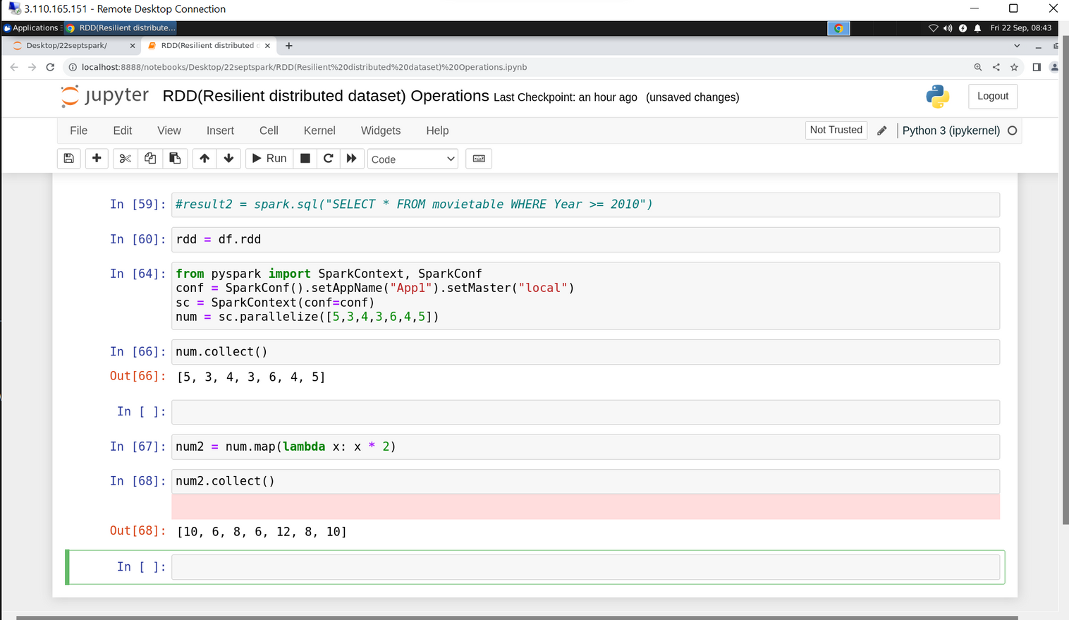
DAY – 4 (PYSPARK 2)
using map function to map values to a new rdd
filtering data using sql queries

Slide 16
Thank you!

